Slide 1

DC-DC Converter for PV Module Integration
Group 760

Slide 2

CONTENT
INTRODUCTION
CONVERTER DESIGN
MPPT ALGORITHM
TESTS RESULTS
DISCUSSION
CONCLUSION

Slide 3
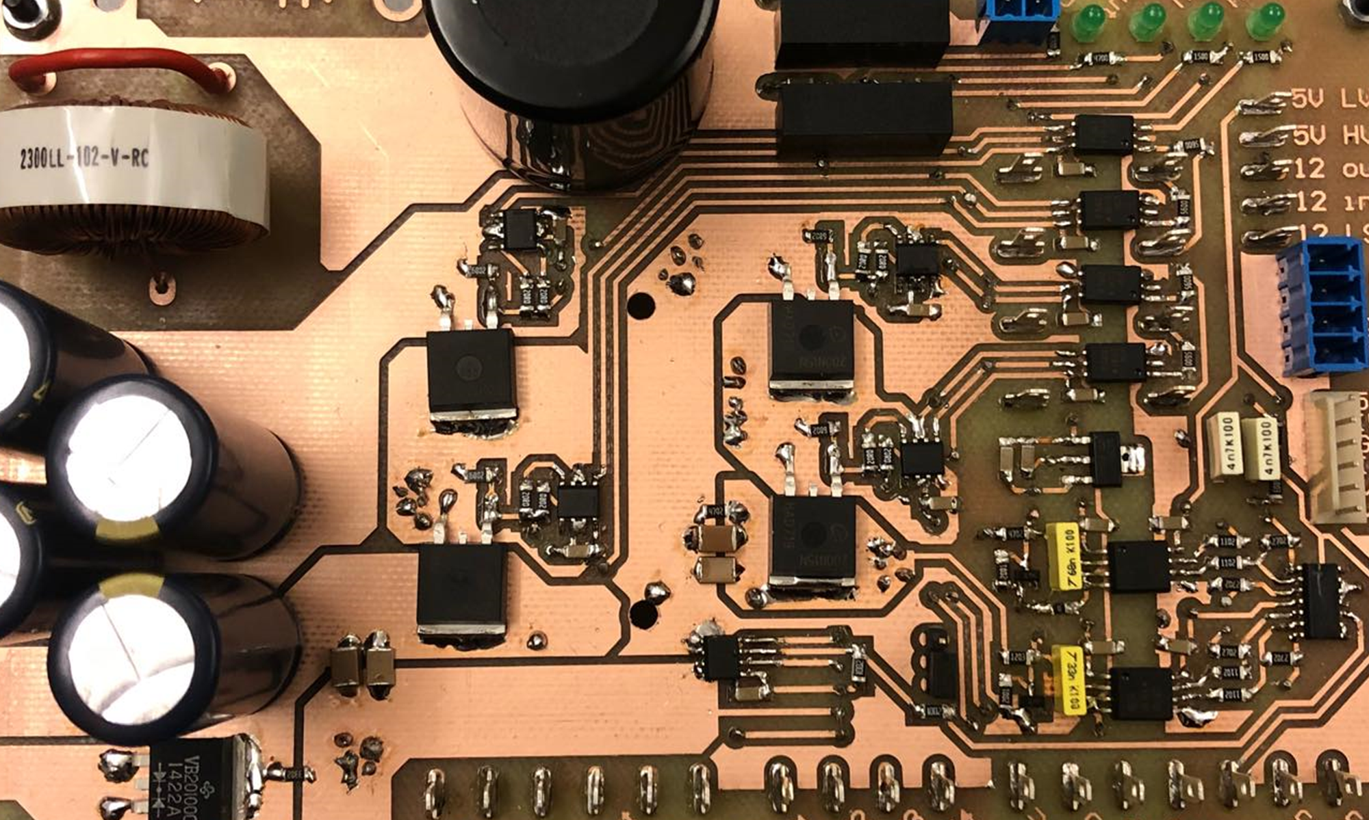
Control of the induction machine

Slide 4
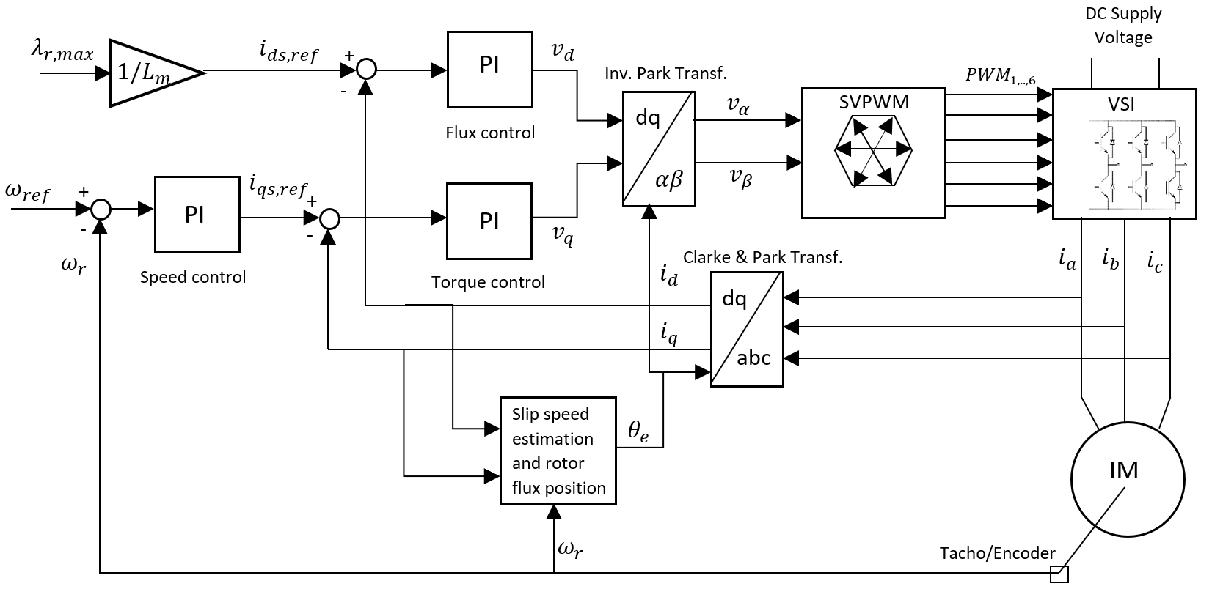
Field Oriented Control (FOC)
Slide
of 59
Estefanía
Notes:
FOC → field orientation in order to achieve independent control of the torque and rotor flux by controlling the stator currents in the dq- reference frame.
Necessary to perform reference frame transformation then the rotor flux field position is found from the rotor mechanical speed and the slip speed.
Two types of control → Torque control (2 PI controllers for torque - iq and flux - id) and Speed control (cascaded controller 3 PIs )
Modulation technique for controlling the gate signals of the VSI → SVPWM
- General block diagram of FOC where we have…..

Slide 5
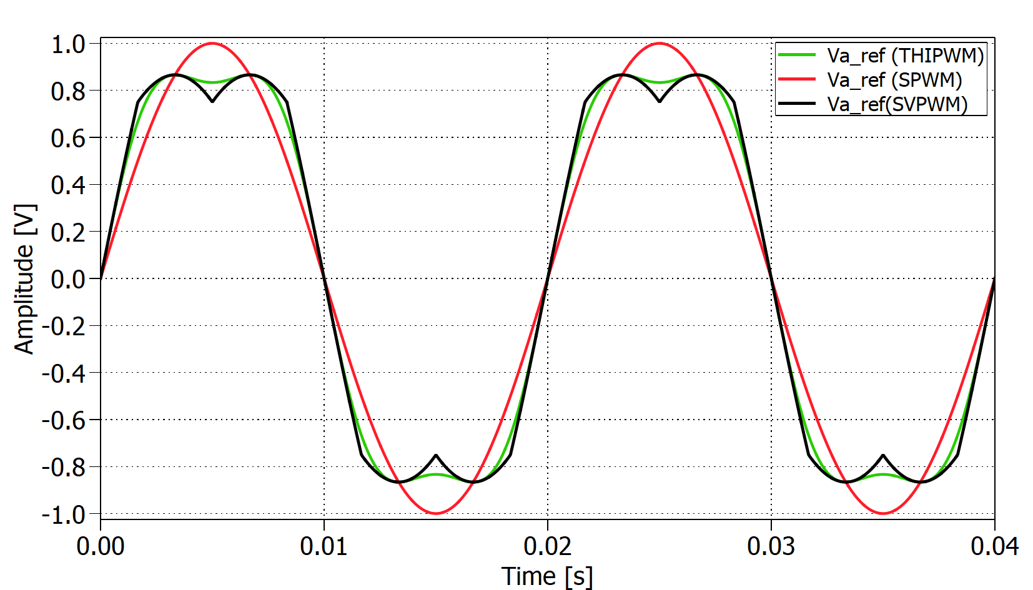
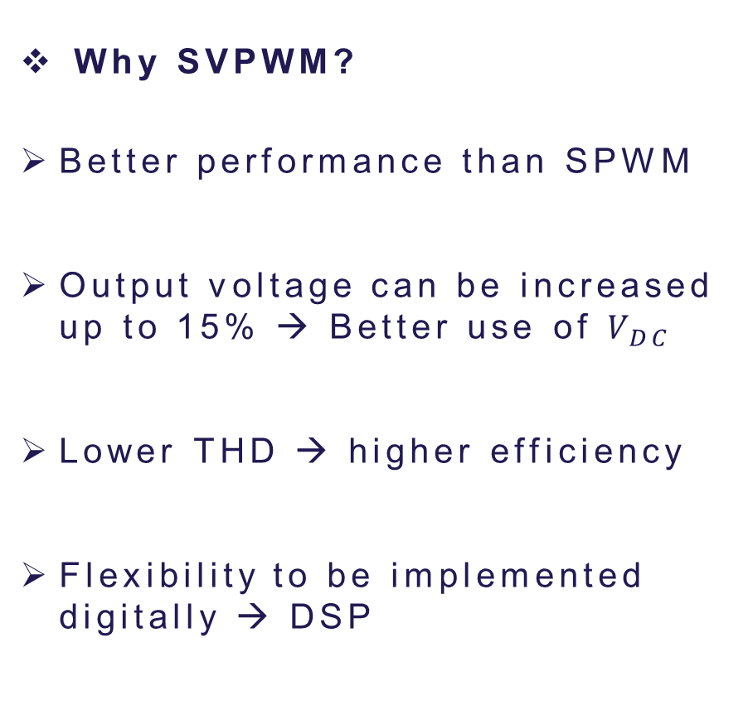
Space Vector Modulation PWM
Slide
of 59
Why SVPWM?
Better performance than SPWM
Output voltage can be increased up to 15% → Better use of $V_{DC}$
Lower THD → higher efficiency
Flexibility to be implemented digitally → DSP
Estefanía
Notes:
Most popular SPWM but has drawbacks as high harmonic distortion
This technique allows to obtain a flattened voltage ref. waveform by reducing the peak voltage by approx 15% compared to fundamental.
Better utilization of Vdc without entering the overmodulation región → low THD
It is decided to select this modulation technique for controlling the VSC of this Project because of these advantages and its flexibility to…
Not mention overmodulation be concise dont explain too much.

Slide 6
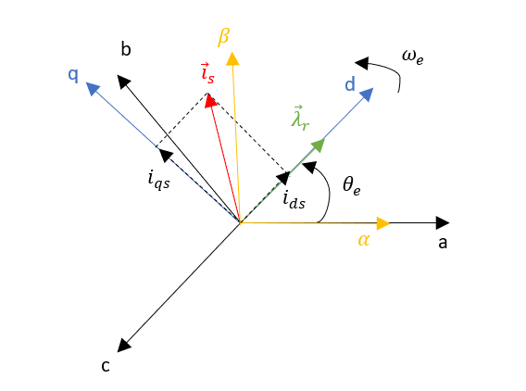
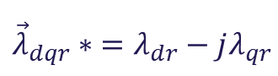
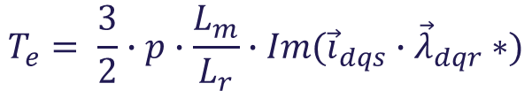
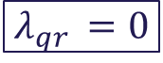
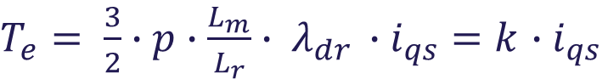
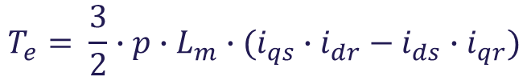

Rotor flux oriented control
Slide
of 59
$$T_{e}= \frac{3}{2}∙p∙L_{m}∙(i_{qs}{∙i}_{dr}− i_{ds}∙i_{qr})$$
Alternate form
$$T_{e}= \frac{3}{2}∙p∙\frac{L_{m}}{L_{r}}∙Im({\vec{i}}_{dqs}∙{\vec{λ}}_{dqr}∗)$$
$${\vec{λ}}_{dqr}∗ =λ_{dr}−jλ_{qr}$$
$$λ_{qr }=0$$
$T_{e}= \frac{3}{2}∙p∙\frac{L_{m}}{L_{r}}∙ λ_{dr }∙i_{qs}=k$ $∙i_{qs}$
$${\vec{i}}_{dqs} =i_{ds}+ ji_{qs}$$
Estefanía
Notes:
Basic idea is to use an arbitrary dq frame where rotor flux is constantly aligned with d-axis as shown on the diagram.
This orientation allows decoupling of the IM torque and flux control variables making it possible to operate the induction machine as a separately excited DC motor.
The general torque equation for an induction machine in the dq frame depends on both iqs and ids however, with FOC by forcing the rotor flux to be in the d-axis rotsting at synchronous speed the q-axis rotor flux becomes zero tghen obtaining the torque as a function of the q-axis current only.
Large Font size in final equation and change kt for k.
The torque is proportional to the q axis current keeping the flux constant!

Slide 7
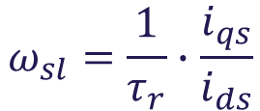

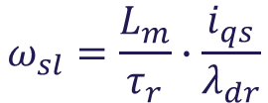


Rotor flux oriented control
Slide
of 59
Determination of rotor flux position ${(θ}_{e})$
0
$u_{qr}=0= R_{r}∙i_{qr}+ \frac{dλ_{qr}}{dt}+(ω_{e}−ω_{r})$ $∙λ_{dr}$
0
$u_{dr}=0= R_{r}∙i_{dr}+ \frac{dλ_{dr}}{dt}−(ω_{e}−ω_{r})$ $∙λ_{qr}$
Slip speed ($ω_{sl}$)
$$ω_{sl}=\frac{L_{m}}{τ_{r}}∙\frac{i_{qs}}{λ_{dr}}$$
$$ω_{sl}=\frac{1}{τ_{r}}∙\frac{i_{qs}}{i_{ds}}$$
$λ_{dr}={ L}_{m}$ ${∙ i}_{ds}$
Estefanía
Notes:
- 2 different ways of implementing FOC for determining the rotor flux position. Depending on the possibility to measure the rotor shaft position of the IM or not, direct or indirect FOC can be implemented. Indirect FOC → Encoder
From the rotor voltage eq of the IM it is obtained that for rotor flux oriented control the terms containing the rotor flux in the q axis disappear and the difference between the synchronous speed w_e and the shaft’s electrical speed is known as slip speed.
To obtain the rotor flux position the slip speed needs to be estimated from the IM equations. It’s obtained that it is a function of the stator currents in the dq fr.
Explain a bit slower the slip part because I was too fast.

Slide 8
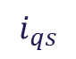
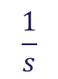
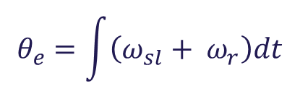





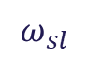

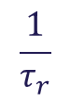
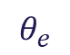



Rotor flux oriented control
Slide
of 59
Determination of rotor flux position ${(θ}_{e})$
$$i_{qs}$$
$$ω_{sl}$$
$$ω_{e}$$
$$×$$
$$\frac{1}{τ_{r}}$$
$$i_{ds}$$
$$+$$
$$÷$$
$$+$$
$$\frac{1}{s}$$
$$θ_{e}$$
$$ω_{r}$$
$$θ_{e}=\int{\left(ω_{sl}+ ω_{r}\right)dt}$$
$$ω_{e}=ω_{sl}+ ω_{r}$$
Estefanía
Notes:
Once the slip speed is estimated, by adding to this speed the rotor speed obtained from the Encoder attached to the shaft, it’s posible to obtain the rotor flux position by integrating the total sum of the speeds.

Slide 9



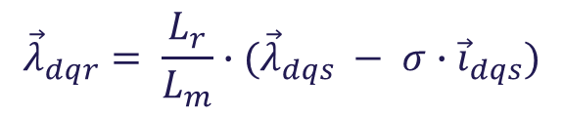
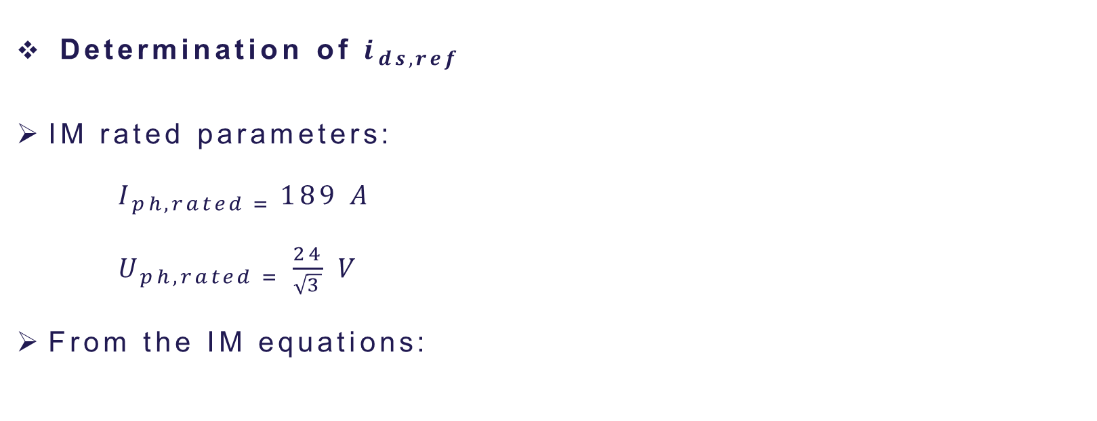
Rotor flux oriented control
Slide
of 59
Determination of $i_{ds,ref}$
IM rated parameters:
$I_{ph,rated = }189 A$
$U_{ph,rated = }\frac{24}{\sqrt{3}} V$
From the IM equations:
$${\vec{λ}}_{dqr}= \frac{L_{r}}{L_{m}}∙({\vec{λ}}_{dqs} − σ∙{\vec{i}}_{dqs})$$
$$λ_{r,max}=0.047 Wb$$
Constant ${ i}_{ds,ref} \text{up} \text{to} \text{rated} \text{speed}$:
$${ i}_{ds,ref}= \frac{λ_{r,max}}{{ L}_{m}}=123.5 A$$
Estefanía
Notes:
From the nameplate of the induction machine the rated voltage and current is obtained to calculate the stator flux linkage. Then the rated rotor flux linkage is calculated in order to obtain the reference for the d-axis current. The IM will perform as expected up to the rated speed which is around 1600rpm. After that point it would be necessary to weaken the flux in order to keep having a proper control of the IM. The motor will opérate in the field weakening región but this isnt scope od the Project.

Slide 10
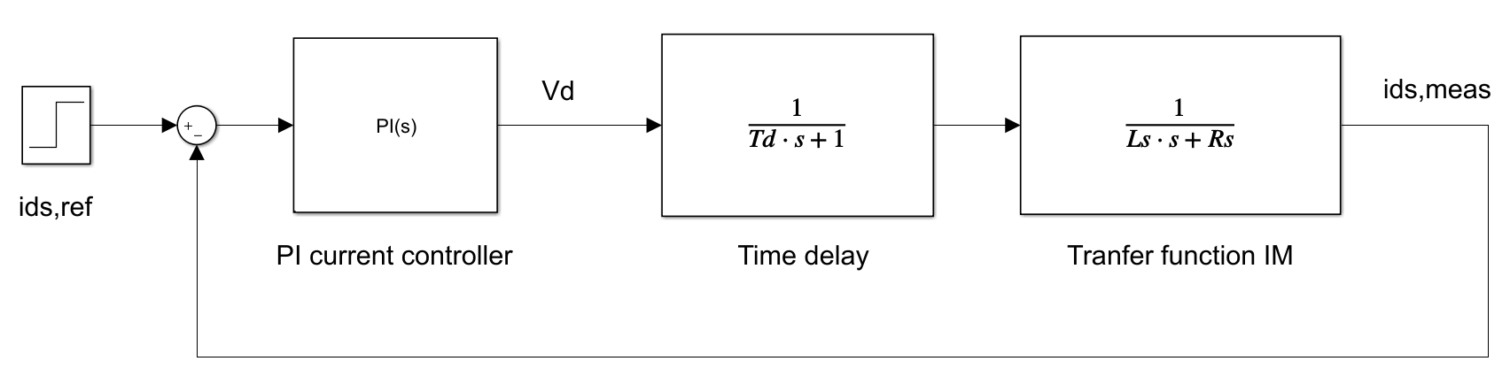
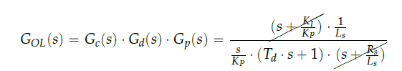
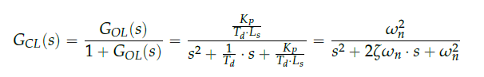

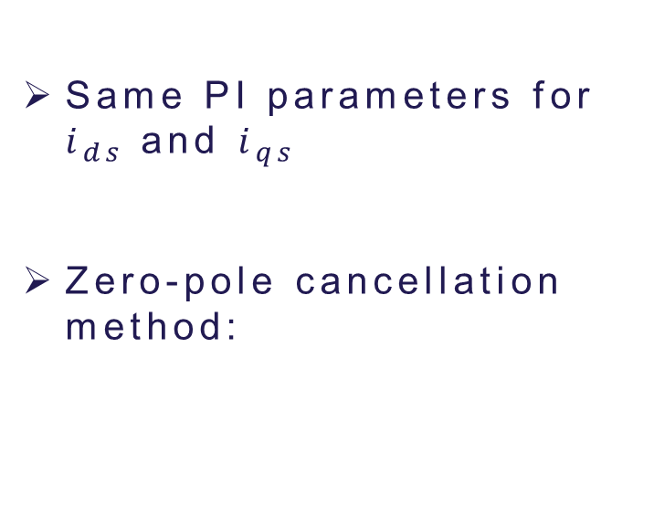
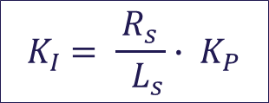


PI current controllers
Slide
of 59
Same PI parameters for $i_{ds}$ and $i_{qs}$
Zero-pole cancellation method:
$${ T}_{d} =0.5∙ { T}_{s}=50 μs$$
$${ K}_{I} = \frac{R_{s}}{{ L}_{s}}∙ { K}_{P}$$
$$ω_{BW} =2 ∙ π∙500 Hz$$
Overshoot < 2%
$${ K}_{P} ={ L}_{s} ∙ { T}_{d} ∙ ω_{n}^{2}$$
Estefanía
Notes:
- The transfer function is the same for the d- and q-axis which means that the current loops for both will be exactly the same.
- The delay appears in the system because of the digital implementation in a microcontroller. The time for sampling the measured signals in the Analog to
Digital Converter (ADC) and the time it takes to perform the control algorithm have to be taken into account. The time delay was reduced as much as possible while programming the microcontroller achieving a total time delay of half a switching period (Td 0.5Ts).
The requirement fot the controller is that the bandwidth should be 500Hz then applying the zero-pole cancellatio nmethod, which consist on placing the controllers zero to cancel the plant’s pole, the Ki is obtain as a fiunction of motor parameters and Kp.

Slide 11
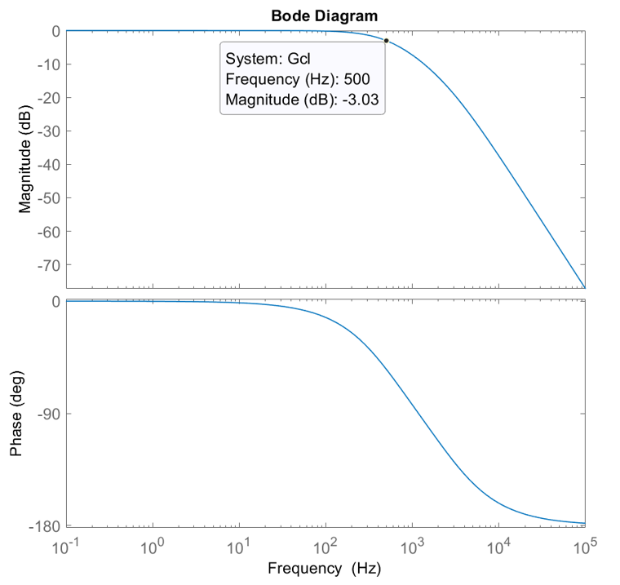
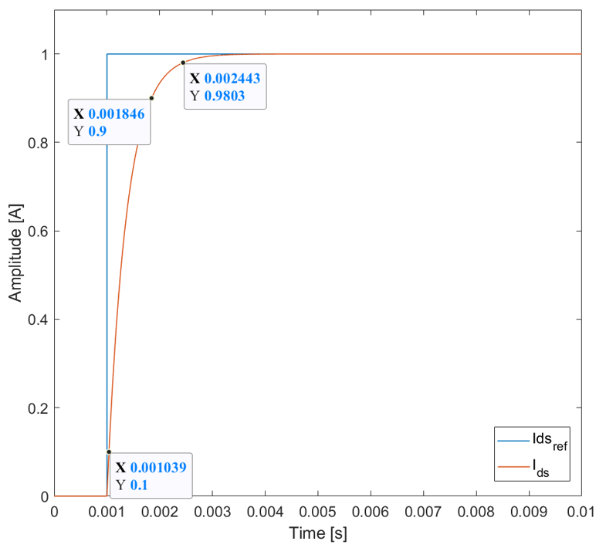
PI current controllers
Slide
of 59
Estefanía

Slide 12
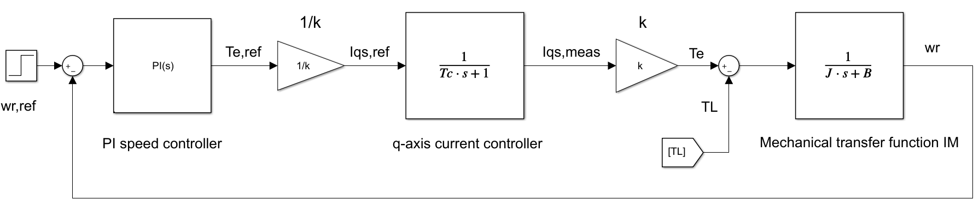
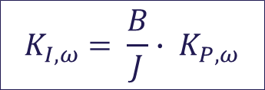
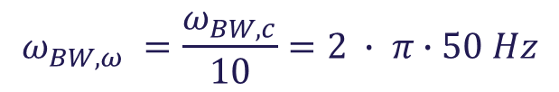
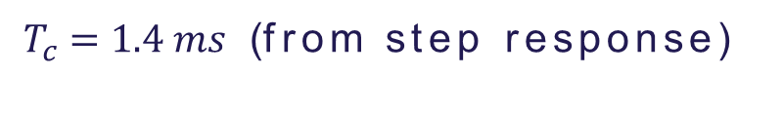

PI speed controller
Slide
of 59
Zero-pole cancellation method:
${ T}_{c} =1.4 ms$ (from step response)
$$ω_{BW,ω} =\frac{ω_{BW,c}}{10}=2 ∙ π∙50 Hz$$
$${ K}_{I,ω} = \frac{B}{J}∙ { K}_{P,ω}$$
$${ K}_{P,ω} =J ∙ { T}_{c} ∙ ω_{n}^{2}$$
Overshoot < 5%
Estefanía
Notes:
- The outer speed loop is governed by the mechanical equation of the induction machine
The closed loop transfer function of the current controller can be reduced to a first order transfer function because the outer speed loop is much slower than the inner loop.
Following the same zero-pole cancellation technique, as done during the design of the current PI controllers, the zero is selected to cancel the induction machine’s pole.

Slide 13
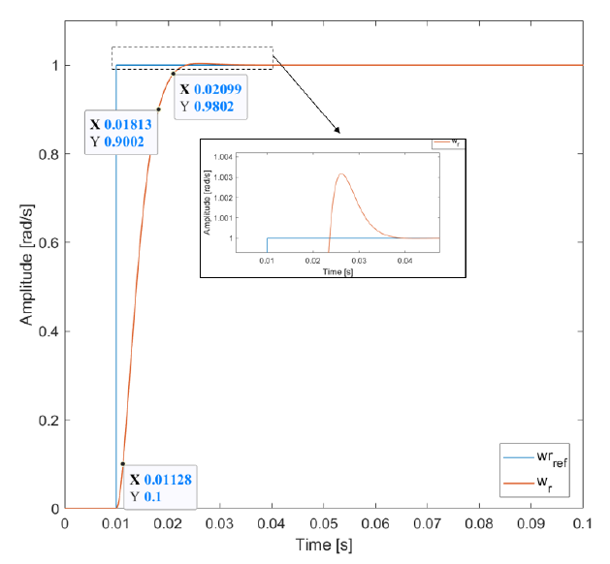
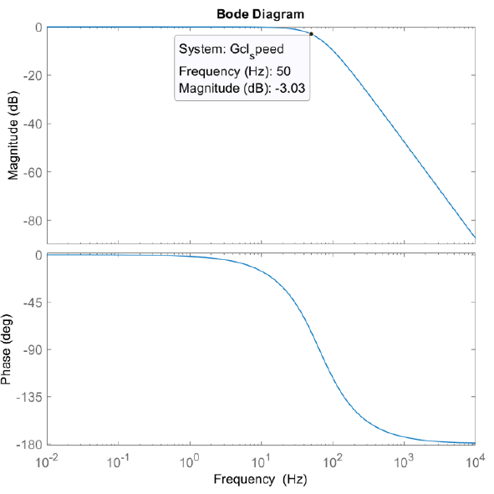
PI speed controller
Slide
of 59
Estefanía

Slide 14

Thank you for your attention
Questions?
[5]

Slide 15
References
[1] http://www.safegardgroup.com/blog/2017/07/27/solar-panel-disposal
[2] https://www.dgem.nl/nl/zonne-energie/opbrengstvariabelen-zonnepanelen
[3] http://www.alternative-energy-tutorials.com/energy-articles/solar-cell-i-v-characteristic.html
[4] MOSFET Gate Drive Circuit, Toshiba, 2018
[5] https://www.thermofisher.com/blog/mining/mining-metals-for-a-renewable-energy-future/

